Slide 1

“Efficient Learning on Imbalanced Image set” M. S. Ramaiah Institute of Technology
Presented by,
Shivani Guldas
RIT-Bengaluru
Guided by,
Lincy Meera Mathews
Assistant Professor
RIT-Bengaluru
(Department of Information Science and Engineering)

Slide 2
Agenda
Scope
Problem statement
Objectives
Literature survey
Proposed system
Challenges
Output
References

Slide 3
Scope
Many fields like agriculture, healthcare, medical, etc make use of image as their data, but the data would be irrelevant or missing or unlabelled which leads to improper dataset.
When the instances of one class is lower than other class then the data is imbalanced and it has to be balanced.
In order to balance the data we have to analyze the image and apply the machine learning techniques and classify the data using appropriate classifiers that help us in overcoming with imbalance problem.

Slide 4
Problem Statement
To balance the imbalanced dataset.

Slide 5
Objectives
To collect imbalanced image dataset
Classify the images
To check system performance
Enhance the images
Improve system performance
Form a balanced image dataset from an efficient classifier.

Slide 6
Literature Survey
Learning from imbalanced data: open challenges and future data
In this paper, author discussed about the current challenges being faced with respect to imbalance data in many real time applications-, the methods to tackle the imbalanced data and future direction to deal with imbalance issue.
Classification with class imbalance problem: A Review
This paper presents an overview on class imbalance classification and the inevitable challenges that come with it. It describes the main issues that hinder the classifier performance in managing highly imbalanced datasets and the many factors that contribute to the class imbalance problems.

Slide 7
Literature Survey (Cont…)
Imbalanced dataset Classification and solutions: A review:
This paper discuss five different levels to handle imbalance data, the methods and algorithms that come under each level. Author discussed about various machine learning tools-WEKA, Rapid Miner etc to work to solve imbalance issue. The evaluation metrics is discussed that help in evaluating classifier performance.
A review on image enhancement techniques with its advantages and disadvantages:
This paper discuss different image enhancement techniques for better quality of images and also discuss advantages and disadvantages of every method.

Slide 8
Literature Survey (Cont…)
Classification of emotions from ECG using KNN classifier:
The paper discuss about the features to consider from the images and how important is the feature extraction in order to classify the data. KNN technique is used to classify the data (ECG data medical image set) and the emotions were classified as happy or sad, the performance of classifier was checked with different imbalance ratios and different ‘k’ values.
Review of image enhancement technique:
The authors discussed two approaches to create synthetic images –spatial domain and frequency domain techniques. Comparison was made between the two approaches and the authors felt difficult in conveying which approach is the best one. They also discussed advantages and disadvantages of both the approaches.

Slide 9
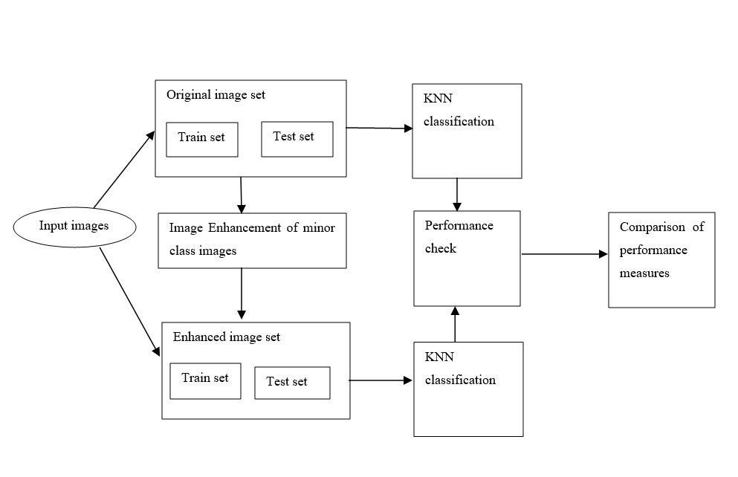
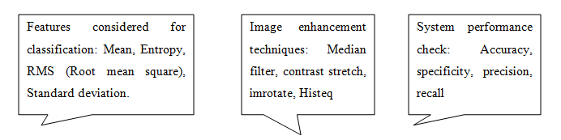
Proposed system

Slide 10
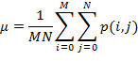
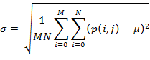
Proposed system-Features Extracted
Mean
The mean is defined as an average of all pixel values of a picture.
p represents pixel value at point i, j of MxN image
Standard Deviation
This normalizes the facts and tell how far our data is from the mean. It is a portion of the spread of a set of values from the average value and also represents dispersion of local regions.
root of pixel ‘p’ at points i, j for MxN image from its mean.

Slide 11
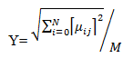
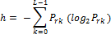
Proposed system-Features Extracted (Cont…)
Root Mean Square
Alias quadratic mean is a statistical measure of the degree of a fluctuating quantity. It is useful when variates are positive and negative. It is the root of mean square value of each row or column or of an entire picture.
Entropy
It is a measure of randomness of a picture used to categorize the surface of a picture. Higher the entropy, higher, the higher miss-categorization. It is a distribution variation in an area.

Slide 12
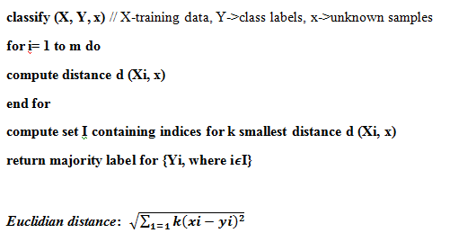
Proposed system-Classification Algorithm- K-NN

Slide 13
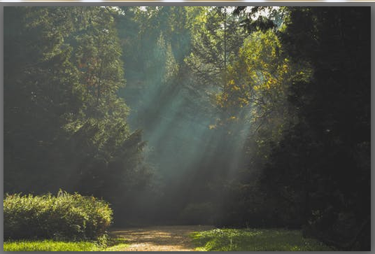
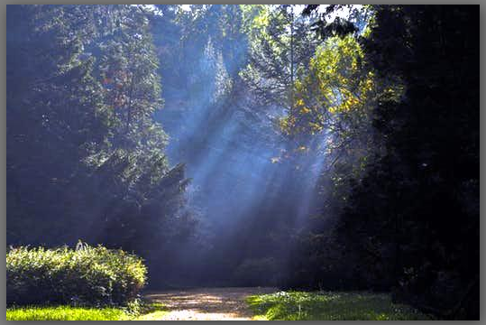
Proposed system-Synthetic Image generation techniques
Contrast Stretch()

Slide 14
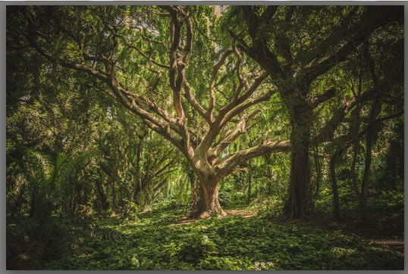
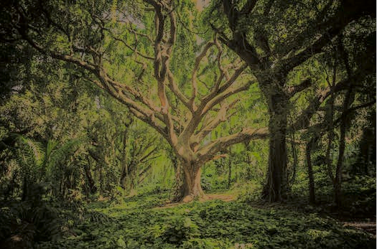
Proposed system-Synthetic Image generation techniques(Cont…)
Brightness preserving Bi-HistEq()

Slide 15
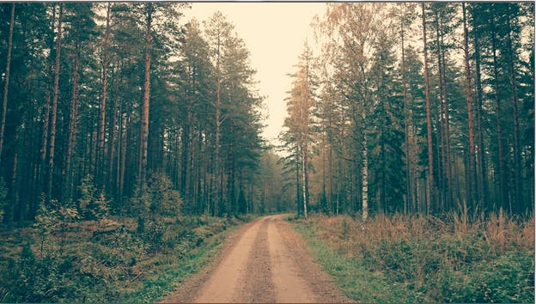
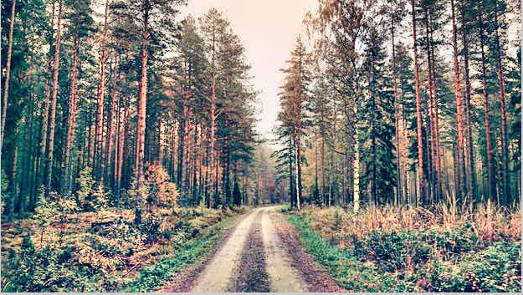
Proposed system-Synthetic Image generation techniques(Cont…)
Adaptive Hist_eq()

Slide 16
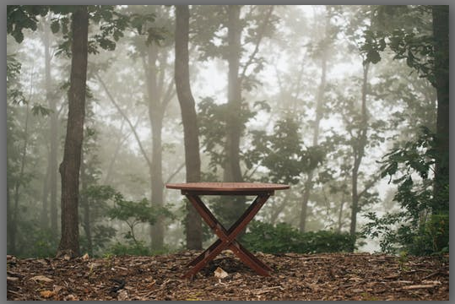
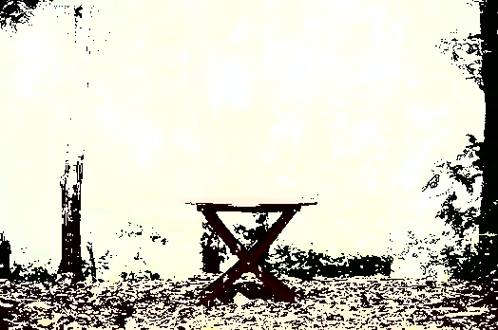
Proposed system-Synthetic Image generation techniques(Cont…)
Contrast Enhancement():

Slide 17
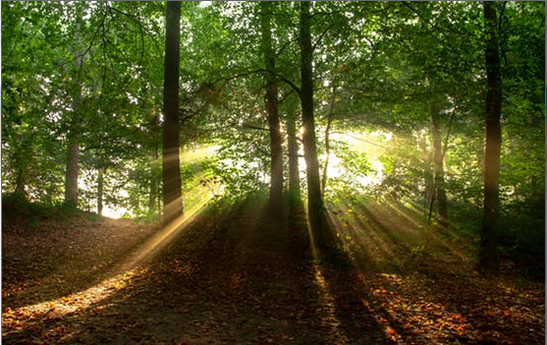
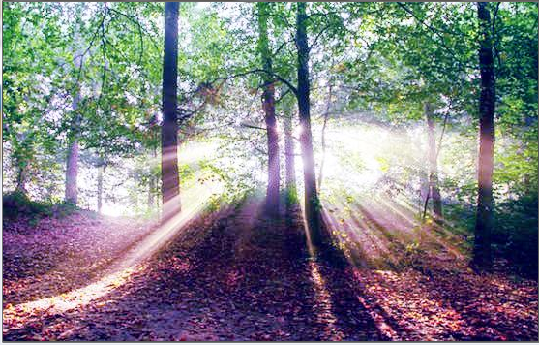
Proposed system-Synthetic Image generation techniques(Cont…)
Histogram Equalization

Slide 18
Proposed system-System performance measures
Specificity
It is the ratio of negative samples identified as negative out of total number of negatives. It is also known as True negative rate and is assessed as:
Specificity= True Negative/ (True Negative + False Positive)
Recall
It is the ratio of correctly predicted positive pixels as positive samples out of all positive samples. It is also known as TPR (true positive rate or sensitivity) and is assessed as:
Recall = True Positive/ (True Positive+ False Negative)
Precision
The ratio of correctly identified as positive samples as positive out of all positive predictions. It is also known as PVV (positive prediction value) and is assessed as:
Precision = True Positive / (True Positive + False Positive)

Slide 19
Challenges
Collection of imbalanced image set
Selection of features for classification
Generation of synthetic images for minor class images
Testing with different imbalance ratio
Improving system performance

Slide 20
Hardware and Software requirements
Hardware requirement:
Win 7, 4GB RAM, 500GB hard disk, Intel core i5 processor, 64/32bit system type.
Software requirement:
MATLAB-2017/2013, image set.

Slide 21
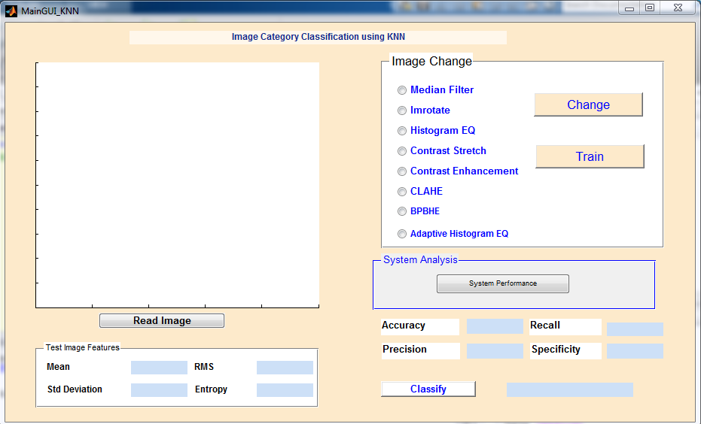
Output

Slide 22
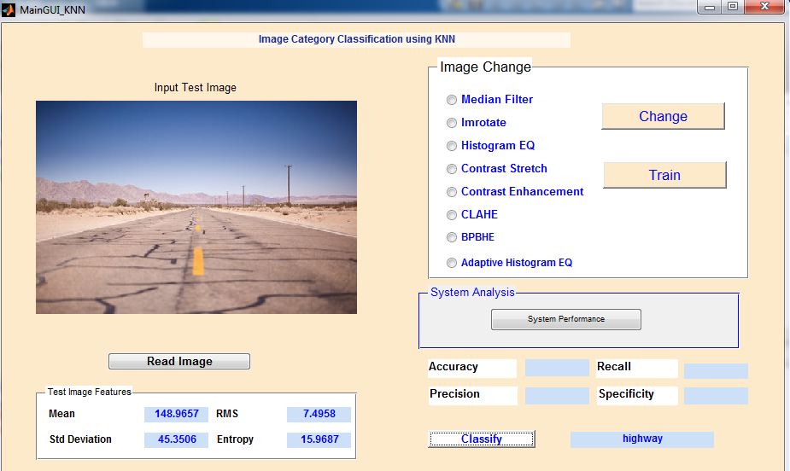
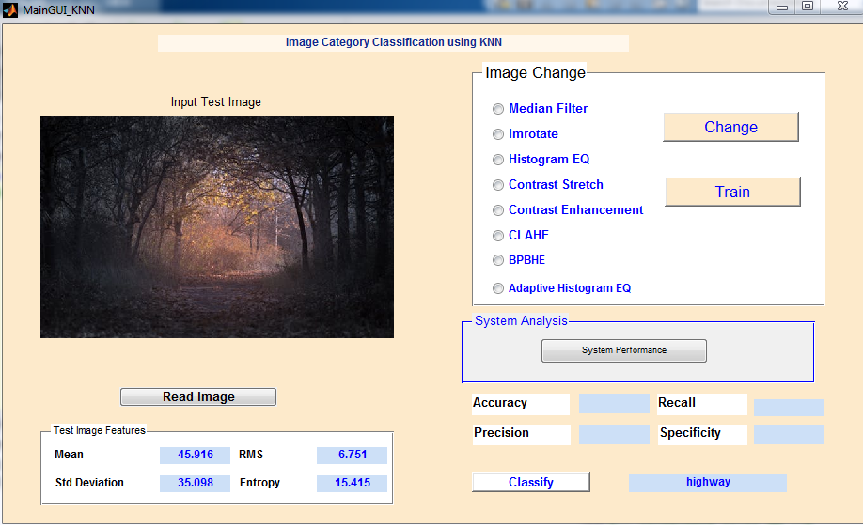
Output- (Classification, misclassification)

Slide 23
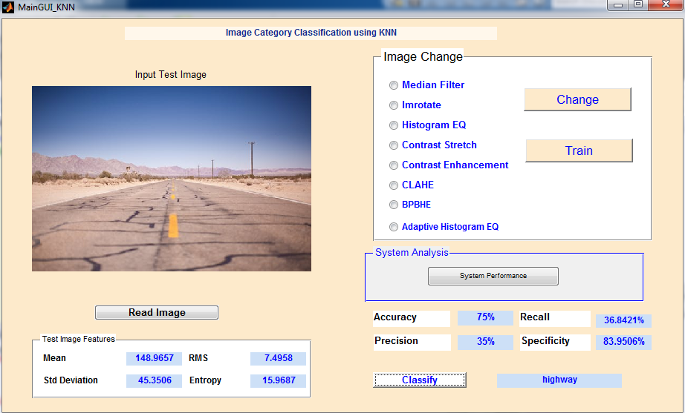
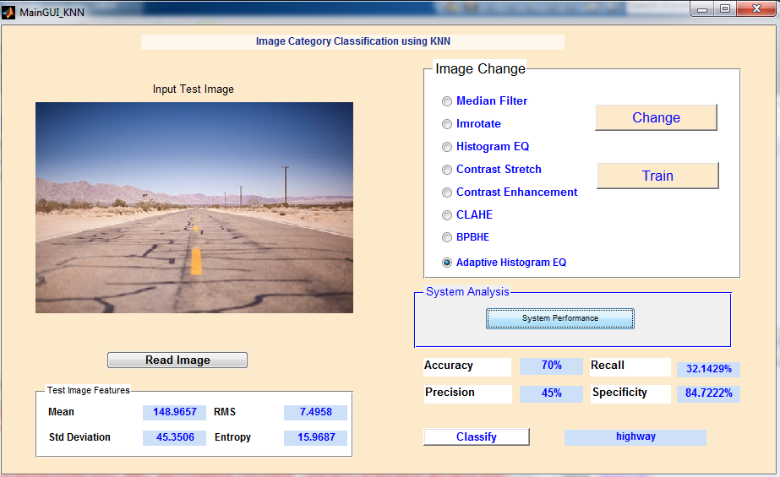
Output- (Adaptive HistEq())

Slide 24
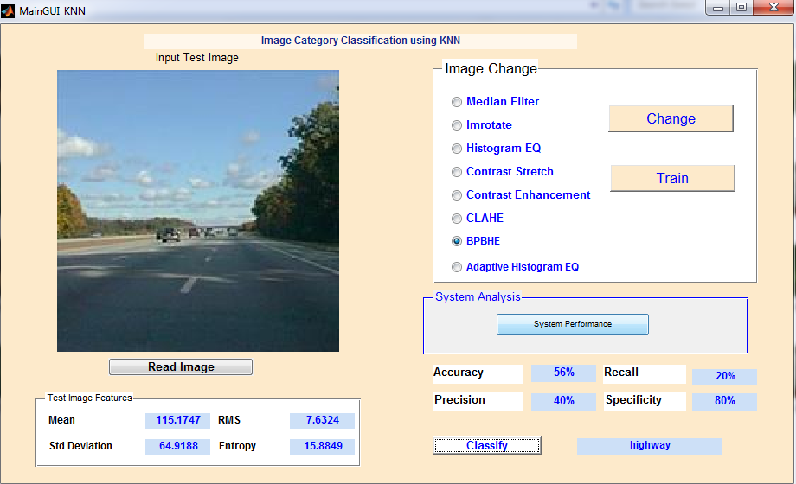
Output- (Brightness preserving Bi-Histogram())

Slide 25
References
“Learning from imbalanced data: open challenges and future data”, Bartosz Krawezyk, Springerlink.com-2016.
“Classification with class imbalance problem: A Review”, “Hebatallah Mostafa Anwer, Mohamed Farouk, Ayman Abdel-HamAida Ali, Siti Mariyam Shamssuddin, Anca L Ralescu”, Intertiol Jourl Of Advances In Soft Computing And Its Applications, 7 (3). pp. 176-204, 2015.
“Classification of emotions from ECG using KNN classifier”, “Vaishnavi L Kaundanya, Anita Patil, Ashish Panat”, IJCST-2015.
“Imbalanced dataset Classification and solutions: A review:”, “Dr. D Ramyachitra, P Manikandan”, July 4 2014, International Journal of Computing and Business Research (IJCBR).
“A review on image enhancement techniques with its advantages and disadvantages”, “Camelia Lamnaru, Andrian Bona, Rodica Potolea”,IEEE-2103.
“Review of image enhancement technique”, “Ruchika Mishra, Utkarsh Sharma”, 2017 7th International Journal of Engineering Research and Technology (IJERT), August 8 2013.
MATLAB tool- www.tutorialspoint.com
www.pexels.com , www.imagenet.com for image set

Slide 26
Thank You…

